Slide 1
Datacamp Case Study Project Wheelchair Ramps

Slide 2
Problem
Wheelchairs are essential for people with special needs or difficulties in movement.
Some places don’t have wheelchair ramps.
Based on the provided data about event venues, program tries to explore data and learn from them.
Our aim is that if program gets data about some event venue it can easily know/predict whether it has wheelchair ramps

Slide 3
What did the program face during learning?
1- The provided data were very useful for our program. However, it had some duplicate info that can confuse our program so it had to be removed.
2- Some data columns (Theatre_max, max_standing and U-Shaped_max) had data that seemed odd compared to the rest of the column, the following graphs will illustrate the problem.

Slide 4
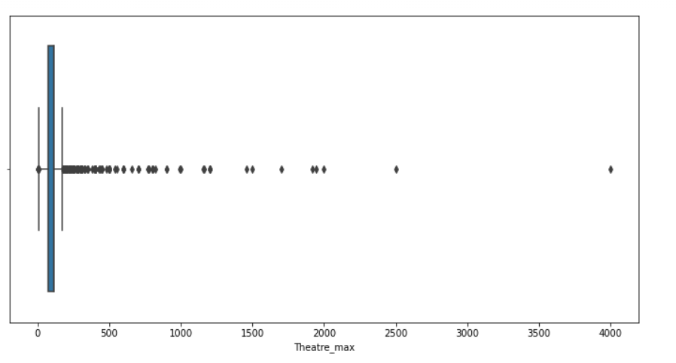
According to this graph, the black dots are data that act as noise that isn’t with the flow of other data.
These data affect the performance of the model and can mislead it during its learning.
They need to be removed.

Slide 5
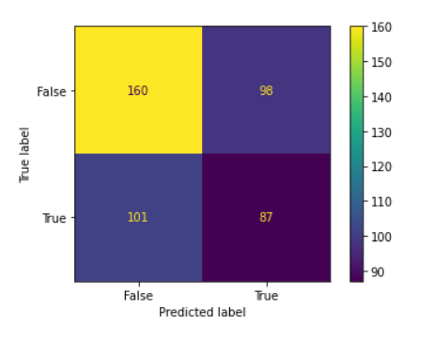
This graph shows the result after removing noise from data.

Slide 6
What faced the program during learning?
3- After removing them the program gave accuracy of average 60%.
With ‘negative’ output accuracy range from 60-80%
The next step was reducing number of columns in data, data consists of 10 columns, program learns from 9 columns to predict the tenth (which is whether venue has ramp), after exploring these 9 columns, some columns seemed more important than others, so I tried to create new columns out of the old ones which summarize their information

Slide 7
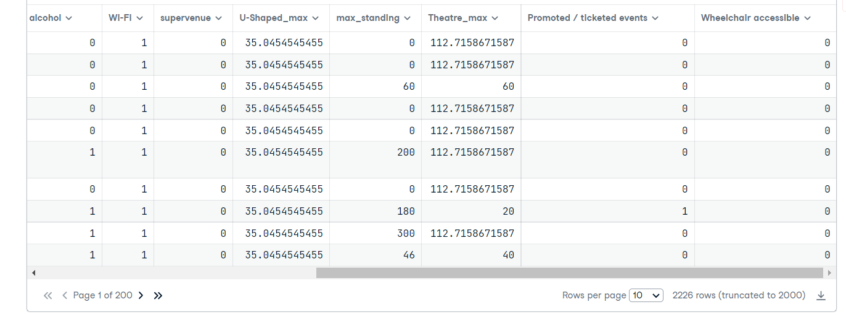
This graph shows part of the original columns.

Slide 8
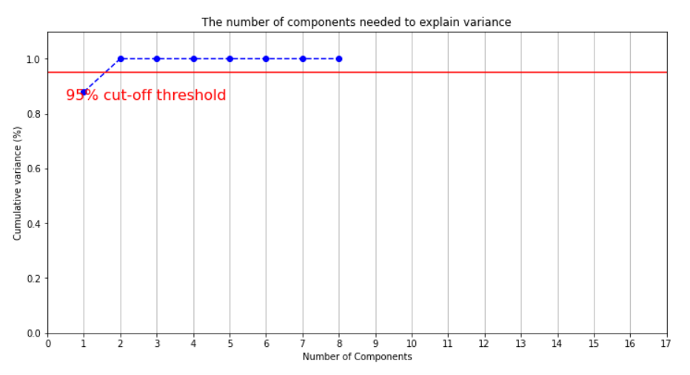
Let’s call it the Reducer
This graph shows the best number of components program can make to replace the old columns, which is in this case 2.

Slide 9
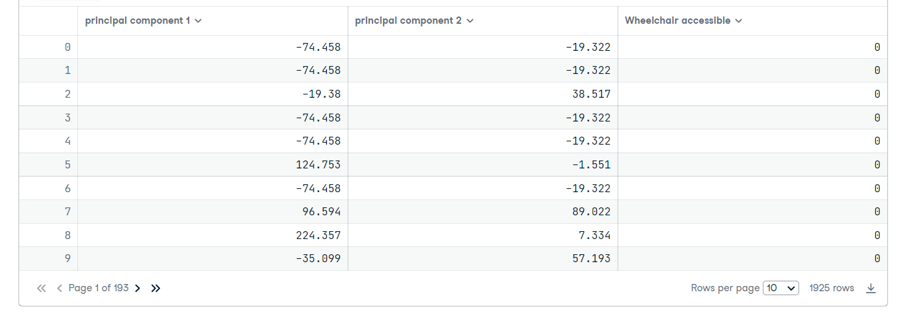
This graph shows after reducing number of columns to only 2 and the output column.

Slide 10
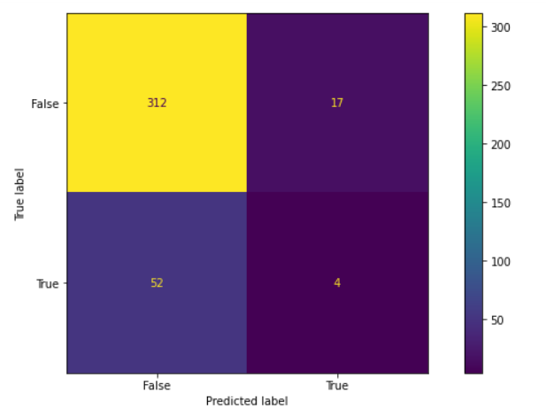
After applying different techniques to make our program learn, we reached out this result.

Slide 11
Program accuracy changed to be 80-85%, which is obviously much better as the program can learn better and give reliable prediction.
True Negatives percentage is 94% which is good approach.

Slide 12
Recommendation
If Dataset has the most important features that affect the output value which is wheelchair accessibility it will be more useful and also will reduce dataset size.

Slide 13
Thank You!

